Slide 1
DIP Homework
D91GP003 Liao Hao Yen

Slide 2
CH4

Slide 3
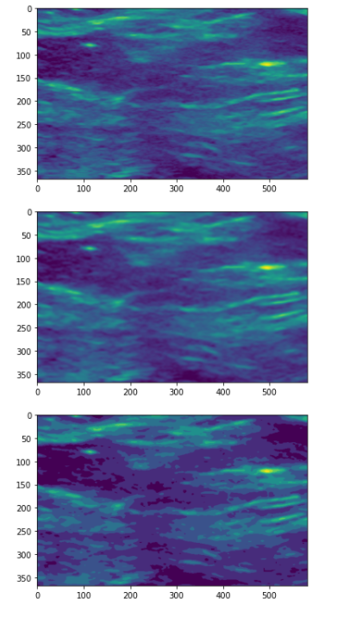
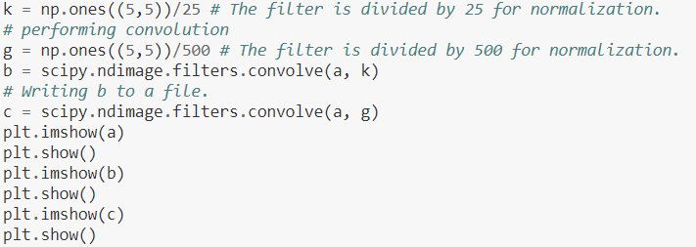
Spatial Filters
Modified part of example

Slide 4
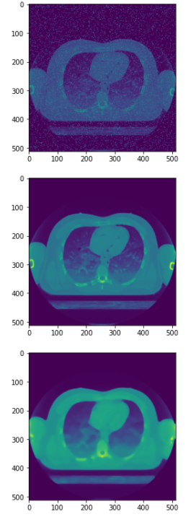
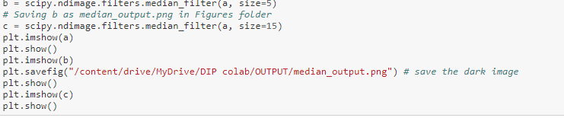
Median Filter
Modified part of example

Slide 5
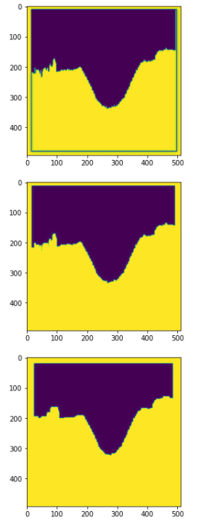
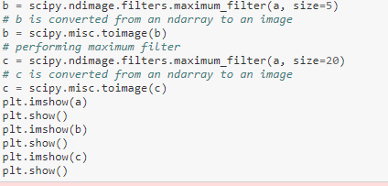
Max Filter
Modified part of example

Slide 6
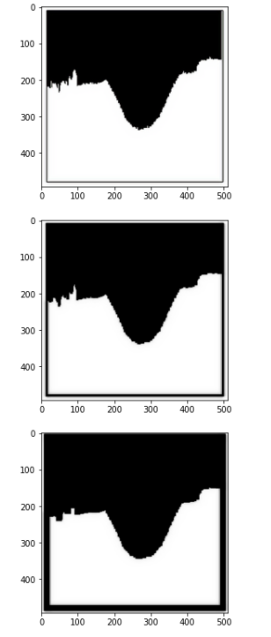
Min Filter
Modified part of example
# performing minimum filter
b = scipy.ndimage.filters.minimum_filter(a, size=5)
# saving b as mino.png
c = scipy.ndimage.filters.minimum_filter(a, size=15)
plt.imshow(a)
plt.show()
plt.imshow(b)
plt.savefig("/content/drive/MyDrive/DIP colab/OUTPUT/mino.png") # save the dark image
plt.show()
plt.imshow(c)
plt.show()

Slide 7
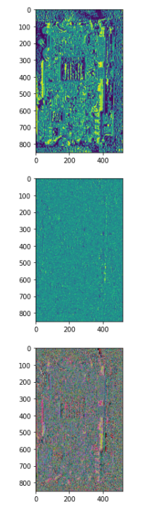
Sobel Filter
Modified part of example
a11 = cv2.imread('/content/drive/MyDrive/DIP colab/prewitt_cir.png')
e = cv2.imread('/content/drive/MyDrive/DIP colab/prewitt_cir.png')
# Converting a to grayscale .
e = cv2.cvtColor(e, cv2.COLOR_BGR2XYZ)
a2 = cv2.cvtColor(a11, cv2.COLOR_BGR2GRAY)
# Performing Sobel filter.
b = ndimage.sobel(a2)
# Saving b.
# Performing Sobel filter.
d = ndimage.sobel(e)
plt.imshow(a2)
plt.show()
plt.imshow(b)
plt.savefig("/content/drive/MyDrive/DIP colab/OUTPUT/prewitt_ciroutput.png") # save the dark image
plt.show()
plt.imshow(d)
plt.show()

Slide 8
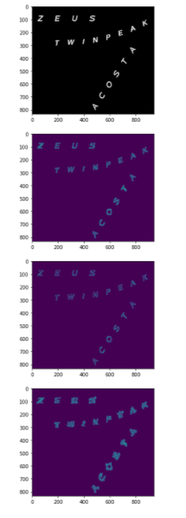
Canny Filter
Modified part of example
b = cv2.Canny(a, 100, 200)
# Saving b.
c = cv2.Canny(a, 500, 200)
# Saving c.
d = cv2.Canny(a, 100, 10)
plt.imshow(a)
plt.show()
plt.imshow(b)
plt.show()
plt.imshow(c)
plt.savefig("/content/drive/MyDrive/DIP colab/OUTPUT/maps1_output.png") # save the dark image
plt.show()
plt.imshow(d)
plt.show()

Slide 9
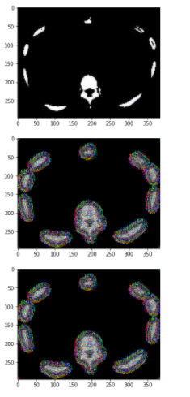
Laplacian Filter
Modified part of example
b = scipy.ndimage.filters.laplace(a,mode='reflect')
# Performing Laplacian filter.
c = scipy.ndimage.filters.laplace(a,mode='mirror')
plt.imshow(a)
plt.show()
plt.imshow(b)
plt.show()
plt.imshow(c)
plt.show()

Slide 10
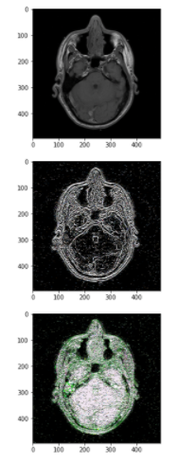
Laplacian of Gaussian Filter
Modified part of example
# Performing Laplacian of Gaussian.
b = scipy.ndimage.filters.gaussian_laplace(a, sigma=1, mode='reflect')
c = scipy.ndimage.filters.gaussian_laplace(a, sigma=1, mode='constant')
plt.imshow(a)
plt.show()
plt.imshow(b)
plt.show()
plt.imshow(c)
plt.show()

Slide 11
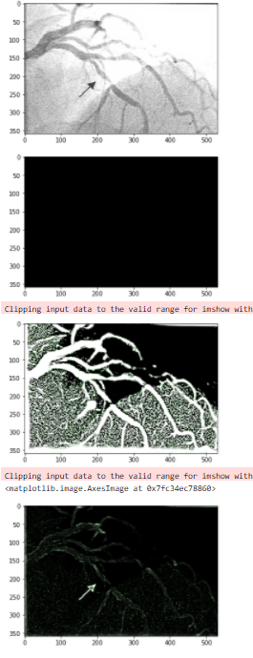
Frangi Filter
Modified part of example
img2 = frangi(img1, black_ridges=True)
img3 = 255*(img2-np.min(img2))/(np.max(img2)-np.min(img2))
img4 = 4*(img2-np.min(img2))/(np.max(img2)-np.min(img2))
plt.imshow(img)
plt.show()
plt.imshow(img2)
plt.show()
plt.imshow(img3)
plt.show()
plt.imshow(img4)

Slide 12
CH5

Slide 13
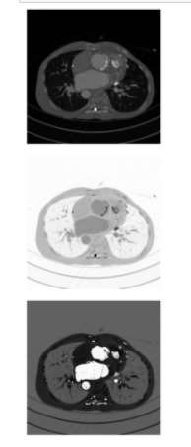
Image Enhancement
Modified part of example
im2 = 255 - im
# Saving the image as imageinverse_output.png in
# Figures folder.
im3 = 100 - im
# Saving the image as imageinverse_output.png in
# Figures folder.
plt.imshow(im)
plt.axis("off")
plt.show()
plt.imshow(im2)
plt.axis("off")
plt.show()
plt.imshow(im3)
plt.axis("off")
plt.show()

Slide 14
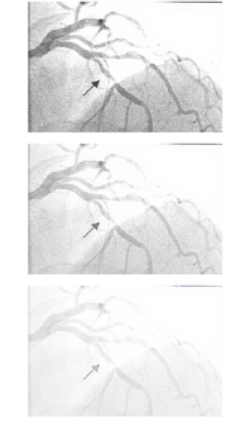
Power Law Transformation
Modified part of example
# b is converted to type float.
b1 = a.astype(float)
# Maximum value in b1 is determined.
b3 = np.max(b1)
# b1 is normalized
b2 = b1/b3
# gamma-correction exponent is computed.
b4 = np.log(b2)*gamma
# gamma-correction is performed.
c = np.exp(b4)*255.0
# c is converted to type int.
c1 = c.astype(int)
# Displaying c1
gamma1 = 0.2
# b is converted to type float.
b11 = a.astype(float)
# Maximum value in b11 is determined.
b31 = np.max(b11)
# b1 is normalized
b21 = b11/b31
# gamma1-correction exponent is computed.
b41 = np.log(b21)*gamma1
# gamma1-correction is performed.
c111 = np.exp(b41)*255.0
# c is converted to type int.
c1111 = c111.astype(int)
# Displaying c1111
plt.axis("off")
plt.imshow(a)
plt.show()
plt.axis("off")
plt.imshow(c1)
plt.show()
plt.axis("off")
plt.imshow(c1111)
plt.show()

Slide 15
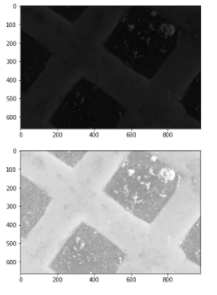
Log Transformation
Modified part of example
b1 = a.astype(float)
# Maximum value in b1 is determined.
b2 = numpy.max(b1)
# Performing the log transformation.
c = (255.0*numpy.log(1+b1))/numpy.log(1+b2)
# c is converted to type int.
c1 = c.astype(int)
# Saving c1 as logtransform_output.png.
plt.imshow(a)
plt.show()
plt.imshow(c1)
plt.savefig("/content/drive/MyDrive/DIP colab/OUTPUT/logtransform_output.png") # save the dark image
plt.show()
plt.close()

Slide 16
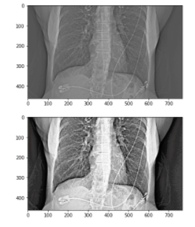
Histogram Equalization
Modified part of example
cdf_m = np.ma.masked_equal(cdf,0)
# Histogram equalization is performed.
num_cdf_m = (cdf_m - cdf_m.min())*255
den_cdf_m = (cdf_m.max()-cdf_m.min())
cdf_m = num_cdf_m/den_cdf_m
# The masked places in cdf_m are now 0.
cdf = np.ma.filled(cdf_m,0).astype('uint8')
# cdf values are assigned in the flattened array.
im2 = cdf[fl]
# im2 is 1D so we use reshape command to.
# make it into 2D.
im3 = np.reshape(im2,img1.shape)
# Saving im3 as hequalization_output.png
# in Figures folder
plt.imshow(img1)
plt.show()
plt.imshow(im3)
plt.savefig("/content/drive/MyDrive/DIP colab/OUTPUT/mhequalization_output.png") # save the dark image
plt.show()

Slide 17
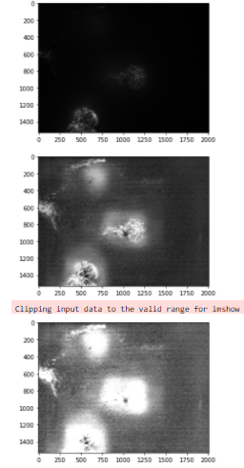
Contrast Limited Adaptive Histogram Equalization
Modified part of example
img3 = img2*2
# Saving img3.
plt.imshow(img)
plt.show()
plt.imshow(img2)
plt.show()
plt.imshow(img3)
plt.savefig("/content/drive/MyDrive/DIP colab/OUTPUT/embryo_output.png") # save the dark image
plt.show(

Slide 18
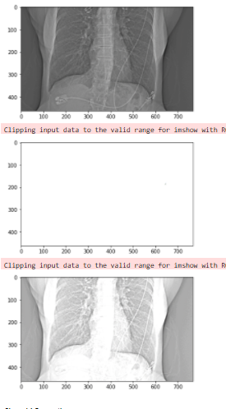
Contrast Stretching
Modified part of example
b = im.max()
a = im.min()
print(a,b)
# Converting im1 to float.
c = im.astype(float)
# Contrast stretching transformation.
im1 = 255.0*(c-a)/(b-a+0.0000001)
im2 = 2.0*(c-a)/(b-a+0.0000001)
# Saving im2 as contrast_output2.png in
# Figures folder
plt.imshow(im)
plt.show()
plt.imshow(im1)
plt.show()
plt.imshow(im2)
plt.savefig("/content/drive/MyDrive/DIP colab/OUTPUT/contrast_output2.png") # save the dark image
plt.show()

Slide 19
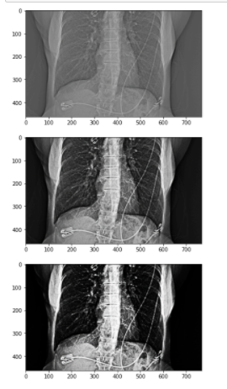
Sigmoid Correction
Modified part of example
img2 = adjust_sigmoid(img1, gain=15)
# Applying Sigmoid correction.
img3 = adjust_sigmoid(img1, gain=30)
# Saving img2.
plt.imshow(img1)
plt.show()
plt.imshow(img2)
plt.savefig("/content/drive/MyDrive/DIP colab/OUTPUT/hequalization_input_img2.png") # save the dark image
plt.show()
plt.imshow(img3)
plt.savefig("/content/drive/MyDrive/DIP colab/OUTPUT/hequalization_input_img3.png") # save the dark image
plt.show(

Slide 20
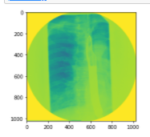
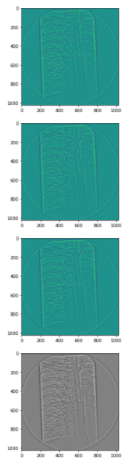
Local Contrast Normalization
Modified part of example
def localfilter(im, sigma=(10, 10,)):
im_gaussian = gaussian_filter(im, sigma=sigma[0])
d = im_gaussian-im
s = np.sqrt(gaussian_filter(d*d, sigma=sigma[1]))
# form an array where all elements have a value of mean(s)
mean_array = np.ones(s.shape)*np.mean(s)
# find element by element maximum between mean_array and s
max_array = np.maximum(mean_array, s)
y = d/(max_array+np.spacing(1.0))
return y
file_name = "/content/drive/MyDrive/DIP colab/FluroWithDisplayShutter.dcm"
dfh = pydicom.read_file(file_name, force=True)
im = dfh.pixel_array
# convert to float and scale before applying filter
im = im.astype(np.float)
im1 = im/np.max(im)
sigma = (5, 5,)
im2 = localfilter(im, sigma)
# rescale to 8-bit
im3 = 255*(im2-im2.min())/(im2.max()-im2.min())
im4 = Image.fromarray(im3).convert("L")
im5 = Image.fromarray(im3).convert("RGB")
plt.imshow(im1)
plt.show()
plt.imshow(im2)
plt.show()
plt.imshow(im3)
plt.show()
plt.imshow(im4)
plt.show()
plt.imshow(im5)
plt.savefig("/content/drive/MyDrive/DIP colab/OUTPUT/FluroWithDisplayShutteroutput.png") # save the dark image
plt.show()

Slide 21
CH6

Slide 22
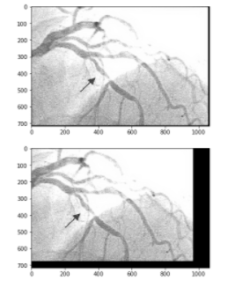
Translation
Modified part of example
mg = Image.open('/content/drive/MyDrive/DIP colab/angiogram1.png').convert('L')
img1 = scipy.misc.fromimage(img)
# translate by 10 pixels in x and 4 pixels in y
transformation = AffineTransform(translation=(10, 4))
transformation1 = AffineTransform(translation=(100, 40))
# nearest neighbor order = 0
img2 = warp(img1, transformation)
img3 = warp(img1, transformation1)
im4 = scipy.misc.toimage(img2).convert('LA')
im5 = scipy.misc.toimage(img3).convert('LA')
# img =
plt.imshow(im4)
plt.show()
plt.imshow(im5)
plt.savefig("/content/drive/MyDrive/DIP colab/OUTPUT/angiogram1_transformation.png") # save the dark image
plt.show()

Slide 23
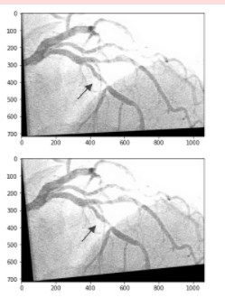
Rotation
Modified part of example
img1 = scipy.misc.fromimage(img)
# rotation angle in radians
transformation = AffineTransform(rotation=0.05)
transformation1 = AffineTransform(rotation=0.1)
img2 = warp(img1, transformation)
img3 = warp(img1, transformation1)
# img4 = scipy.misc.toimage(img2).convert('LA')
plt.imshow(img2)
plt.show()
plt.imshow(img3)
plt.savefig("/content/drive/MyDrive/DIP colab/OUTPUT/angiogram1_Rotation.png") # save the dark image
plt.show()

Slide 24
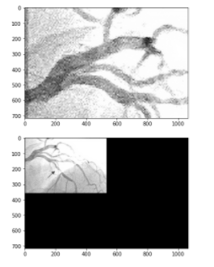
Scaling
Modified part of example
img1 = scipy.misc.fromimage(img)
#scale by1/2 on both x and y.
transformation = AffineTransform(scale= (0.5, 0.5))
transformation1 = AffineTransform(scale= (2, 2))
img2 = warp(img1, transformation)
img3 = warp(img1, transformation1)
im4 = scipy.misc.toimage(img2).convert('LA')
im5 = scipy.misc.toimage(img3).convert('LA')
plt.imshow(im4)
plt.show()
plt.imshow(im5)
plt.savefig("/content/drive/MyDrive/DIP colab/OUTPUT/angiogram1_Scaling.png") # save the dark image
plt.show()

Slide 25
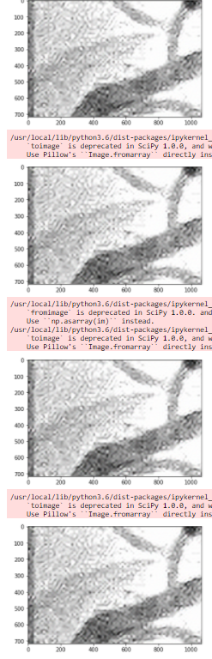
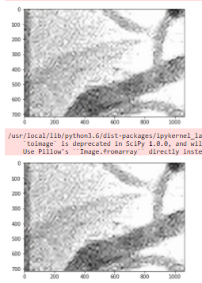
Interpolation
Modified part of example
# nearest neighbor order = 0
img2 = warp(img1, transformation, order=0)
im4 = scipy.misc.toimage(img2)
plt.imshow(im4)
plt.show()
# bi-linear order = 1
img2 = warp(img1, transformation, order=1) # default
im4 = scipy.misc.toimage(img2)
plt.imshow(im4)
plt.show()
#bi-quadratic order = 2
img2 = warp(img1, transformation, order=2)
im4 = scipy.misc.toimage(img2)
plt.imshow(im4)
plt.show()
#bi-cubic order = 3
img2 = warp(img1, transformation, order=3)
im4 = scipy.misc.toimage(img2)
plt.imshow(im4)
plt.show()
#------------------------------------------------------------------
img10 = Image.open('/content/drive/MyDrive/DIP colab/angiogram1.png')
img11 = scipy.misc.fromimage(img)
transformation = AffineTransform(scale=(0.3, 0.3))
# order = 4
img21 = warp(img11, transformation, order=4) # default
im41 = scipy.misc.toimage(img21)
plt.imshow(im41)
plt.show()
# order = 5
img21 = warp(img11, transformation, order=5)
im41 = scipy.misc.toimage(img21)
plt.imshow(im41)
plt.show()

Slide 26
CH7

Slide 27
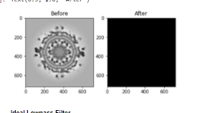
Fast Fourier Transform using Python
Modified part of example
b = Image.open('/content/drive/MyDrive/DIP colab/fft1.png').convert('L')
#f = np.fft.ifft2(b, s=None, axes=(-2,-1))
# Performing FFT.
c = abs(fftim.fft2(b))
# Shifting the Fourier frequency image.
d = fftim.fftshift(c)
# Converting the d to floating type and saving it
# as fft1_output.raw in Figures folder.
d.astype('float').tofile('/content/drive/MyDrive/DIP colab/OUTPUT/fft1_output.raw')
print(d)
fig = plt.figure()
ax = fig.add_subplot(1, 2, 1)
imgplot = plt.imshow(b, cmap='gray')
ax.set_title('Before')
ax = fig.add_subplot(1, 2, 2)
imgplot = plt.imshow(d, cmap='gray')
ax.set_title('After')

Slide 28
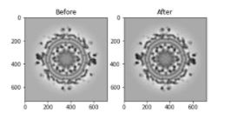
Ideal Lowpass Filter
Modified part of example
b = Image.open('/content/drive/MyDrive/DIP colab/fft1.png').convert('L')
# Performing FFT.
c = fftim.fft2(b)
# Shifting the Fourier frequency image.
d = fftim.fftshift(c)
# Intializing variables for convolution function.
M = d.shape[0]
N = d.shape[1]
# H is defined and
# values in H are initialized to 1.
H = numpy.ones((M,N))
center1 = M/2
center2 = N/2
d_0 = 30.0 # cut-off radius
# Defining the convolution function for ILPF.
for i in range(1,M):
for j in range(1,N):
r1 = (i-center1)**2+(j-center2)**2
# Euclidean distance from
# origin is computed.
r = math.sqrt(r1)
# Using cut-off radius to eliminate
# high frequency.
if r > d_0:
H[i,j] = 0.0
# Converting H to an image.
H = Image.fromarray(H)
# Performing the convolution.
con = d * H
# Computing the magnitude of the inverse FFT.
e = abs(fftim.ifft2(con))
# Saving e as ilowpass_output.png in
# Figures folder .
fig = plt.figure()
ax = fig.add_subplot(1, 2, 1)
imgplot = plt.imshow(b, cmap='gray')
ax.set_title('Before')
ax = fig.add_subplot(1, 2, 2)
imgplot = plt.imshow(e, cmap='gray')
ax.set_title('After'

Slide 29
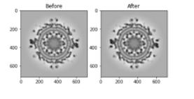
Butterworth Lowpass Filter
Modified part of example
c = fftim.fft2(b)
# Shifting the Fourier frequency image.
d = fftim.fftshift(c)
# Intializing variables for convolution function.
M = d.shape[0]
N = d.shape[1]
# H is defined and
# values in H are initialized to 1.
H = numpy.ones((M,N))
center1 = M/2
center2 = N/2
d_0 = 30.0 # cut-off radius
t1 = 1 # the order of BLPF
t2 = 2*t1
# Defining the convolution function for BLPF.
for i in range(1,M):
for j in range(1,N):
r1 = (i-center1)**2+(j-center2)**2
# Euclidean distance from
# origin is computed.
r = math.sqrt(r1)
# Using cut-off radius to
# eliminate high frequency.
if r > d_0:
H[i,j] = 1/(1 + (r/d_0)**t1)
# Converting H to an image
H = Image.fromarray(H)
# Performing the convolution.
con = d * H
# Computing the magnitude of the inverse FFT.
e = abs(fftim.ifft2(con))
# Saving e.
fig = plt.figure()
ax = fig.add_subplot(1, 2, 1)
imgplot = plt.imshow(b, cmap='gray')
ax.set_title('Before')
ax = fig.add_subplot(1, 2, 2)
imgplot = plt.imshow(e, cmap='gray')
ax.set_title('After')

Slide 30
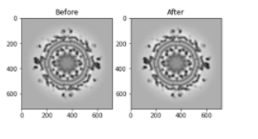
Gaussian Lowpass Filter
Modified part of example
c = fftim.fft2(b)
# Shifting the Fourier frequency image.
d = fftim.fftshift(c)
# Intializing variables for convolution function.
M = d.shape[0]
N = d.shape[1]
# H is defined and
# values in H are initialized to 1.
H = numpy.ones((M,N))
center1 = M/2
center2 = N/2
d_0 = 30.0 # cut-off radius
t1 = 2*d_0
# Defining the convolution function for GLPF
for i in range(1,M):
for j in range(1,N):
r1 = (i-center1)**2+(j-center2)**2
# euclidean distance from
# origin is computed
r = math.sqrt(r1)
# using cut-off radius to
# eliminate high frequency
if r > d_0:
H[i,j] = math.exp(-r**2/t1**2)
# Converting H to an image.
H = Image.fromarray(H)
# Performing the convolution.
con = d * H
# Computing the magnitude of the inverse FFT.
e = abs(fftim.ifft2(con))
# Saving the image as glowpass_output.png in
# Figures folder .
fig = plt.figure()
ax = fig.add_subplot(1, 2, 1)
imgplot = plt.imshow(b, cmap='gray')
ax.set_title('Before')
ax = fig.add_subplot(1, 2, 2)
imgplot = plt.imshow(e, cmap='gray')
ax.set_title('After')

Slide 31
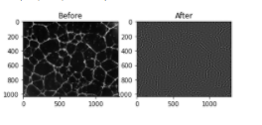
Ideal Highpass Filter
c = fftim.fftshift(b)
# intializing variables for convolution function
M = c.shape[0]
N = c.shape[1]
# H is defined and
# values in H are initialized to 1.
H = numpy.ones((M,N))
center1 = M/2
center2 = N/2
d_0 = 30.0 # cut-off radius
# Defining the convolution function for IHPF.
for i in range(1,M):
for j in range(1,N):
r1 = (i-center1)**2+(j-center2)**2
# Euclidean distance from
# origin is computed.
r = math.sqrt(r1)
# Using cut-off radius to
# eliminate low frequency.
if 0 < r < d_0:
H[i,j] = 0.0
# Performing the convolution.
con = c * H
# Computing the magnitude of the inverse FFT.
d = abs(fftim.ifft2(con))
# Saving the image as ihighpass_output.png in
# Figures folder.
fig = plt.figure()
ax = fig.add_subplot(1, 2, 1)
imgplot = plt.imshow(a, cmap='gray')
ax.set_title('Before')
ax = fig.add_subplot(1, 2, 2)
imgplot = plt.imshow(d, cmap='gray')
ax.set_title('After')
Modified part of example

Slide 32
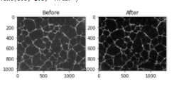
Butterworth Highpass Filter
Modified part of example
# values in H are initialized to 1.
H = numpy.ones((M,N))
center1 = M/2
center2 = N/2
d_0 = 30.0 # cut-off radius
t1 = 1 # the order of BHPF
t2 = 2*t1
# Defining the convolution function for BHPF.
for i in range(1,M):
for j in range(1,N):
r1 = (i-center1)**2+(j-center2)**2
# Euclidean distance from
# origin is computed.
r = math.sqrt(r1)
# Using cut-off radius to
# eliminate low frequency.
if 0 < r < d_0:
H[i,j] = 1/(1 + (r/d_0)**t2)
# Converting H to an image.
H = Image.fromarray(H)
# performing the convolution
con = d * H
# computing the magnitude of the inverse FFT
fig = plt.figure()
ax = fig.add_subplot(1, 2, 1)
imgplot = plt.imshow(a, cmap='gray')
ax.set_title('Before')
ax = fig.add_subplot(1, 2, 2)
imgplot = plt.imshow(b, cmap='gray')
ax.set_title('After')

Slide 33
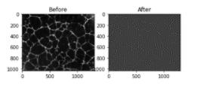
Gaussian Highpass Filter
# Intializing variables for convolution function.
M = c.shape[0]
N = c.shape[1]
# H is defined and values in H are initialized to 1.
H = numpy.ones((M,N))
center1 = M/2
center2 = N/2
d_0 = 30.0 # cut-off radius
t1 = 2*d_0
# Defining the convolution function for GHPF.
for i in range(1,M):
for j in range(1,N):
r1 = (i-center1)**2+(j-center2)**2
# Euclidean distance from
# origin is computed.
r = math.sqrt(r1)
# Using cut-off radius to
# eliminate low frequency.
if 0 < r < d_0:
H[i,j] = 1 - math.exp(-r**2/t1**2)
# Converting H to an image.
H = Image.fromarray(H)
# Performing the convolution.
con = c * H
# Computing the magnitude of the inverse FFT.
e = abs(fftim.ifft2(con))
# Saving the image as ghighpass_output.png in
# Figures folder.
fig = plt.figure()
ax = fig.add_subplot(1, 2, 1)
imgplot = plt.imshow(a, cmap='gray')
ax.set_title('Before')
ax = fig.add_subplot(1, 2, 2)
imgplot = plt.imshow(e, cmap='gray')
ax.set_title('After')
Modified part of example

Slide 34
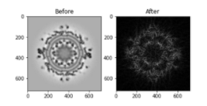
Bandpass Filter
Modified part of example
# Shifting the Fourier frequency image .
d = fftim.fftshift(c)
# Intializing variables for convolution function.
M = d.shape[0]
N = d.shape[1]
# H is defined and
# values in H are initialized to 1.
H = numpy.zeros((M,N))
center1 = M/2
center2 = N/2
d_0 = 30.0 # minimum cut-off radius
d_1 = 50.0 # maximum cut-off radius
# Defining the convolution function for bandpass
for i in range(1,M):
for j in range(1,N):
r1 = (i-center1)**2+(j-center2)**2
# Euclidean distance from
# origin is computed.
r = math.sqrt(r1)
# Using min and max cut-off to create
# the band or annulus.
if r > d_0 and r < d_1:
H[i,j] = 1.0
# Converting H to an image.
H = Image.fromarray(H)
# Performing the convolution.
con = d * H
# Computing the magnitude of the inverse FFT.
e = abs(fftim.ifft2(con))
# Saving the image as ibandpass_output.png.
fig = plt.figure()
ax = fig.add_subplot(1, 2, 1)
imgplot = plt.imshow(b, cmap='gray')
ax.set_title('Before')
ax = fig.add_subplot(1, 2, 2)
imgplot = plt.imshow(e, cmap='gray')
ax.set_title('After')

Slide 35
CH8

Slide 36
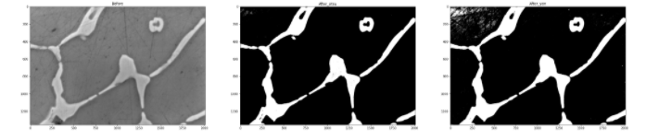
Segmentation
Modified part of example
thresh = threshold_otsu(a)
thresh1 = filters.threshold_yen(a)
print('thresh_otsu',thresh)
print('thresh_yen',thresh1)
# Pixels with intensity greater than the
# "threshold" are kept.
b = 255*(a > thresh)
c = 255*(a > thresh1)
# Saving the image.
fig = plt.figure(figsize=(36, 36))
ax = fig.add_subplot(1, 3, 1)
imgplot = plt.imshow(a, cmap='gray')
ax.set_title('Before')
ax = fig.add_subplot(1, 3, 2)
imgplot = plt.imshow(b, cmap='gray')
ax.set_title('After_otsu')
ax = fig.add_subplot(1, 3, 3)
imgplot = plt.imshow(c, cmap='gray')
ax.set_title('After_yen')
plt.show()

Slide 37
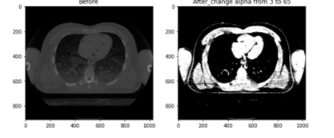
Renyi Entropy
def renyi_seg_fn(im, alpha):
hist, _ = imexp.histogram(im)
# Convert all values to float
hist_float = np.array([float(i) for i in hist])
# compute the pdf
pdf = hist_float/np.sum(hist_float)
# compute the cdf
cumsum_pdf = np.cumsum(pdf)
s, e = im.min(), im.max()
scalar = 1.0/(1.0-alpha)
# A very small value to prevent error due to log(0).
eps = np.spacing(1)
rr = e-s
# The inner parentheses is needed because
# the parameters are tuple.
h1 = np.zeros((rr, 1))
h2 = np.zeros((rr, 1))
# The following loop computes h1 and h2
# values used to compute the entropy.
for ii in range(1, rr):
iidash = ii+s
temp0 = pdf[0:iidash]/(cumsum_pdf[iidash])
temp1 = np.power(temp0, alpha)
h1[ii] = np.log(np.sum(temp1)+eps)
temp0 = pdf[iidash+1:e]/(1.0-cumsum_pdf[iidash])
temp2 = np.power(temp0, alpha)
h2[ii] = np.log(np.sum(temp2)+eps)
T = h1+h2
# Entropy value is calculated
T = T*scalar
T = T.reshape((rr, 1))[:-2]
# location where the maximum entropy
# occurs is the threshold for the renyi entropy
thresh = T.argmax(axis=0)
return thresh
# Main program
# Opening the image and converting it to grayscale.
a = Image.open('/content/drive/MyDrive/DIP colab/CT.png').convert('L')
a = np.array(a)
# Computing the threshold by calling the function.
thresh = renyi_seg_fn(a, 65)
print('The renyi threshold is: ', thresh[0])
b = 255*(a > thresh)
# Saving the image as renyi_output.png
fig = plt.figure(figsize=(10, 10))
ax = fig.add_subplot(1, 2, 1)
imgplot = plt.imshow(a, cmap='gray')
ax.set_title('Before')
ax = fig.add_subplot(1, 2, 2)
imgplot = plt.imshow(b, cmap='gray')
ax.set_title('After_change alpha from 3 to 65')
plt.show()
Modified part of example

Slide 38

Adaptive Thresholdin
Modified part of example
a = Image.open('/content/drive/MyDrive/DIP colab/adaptive_example1.png'). \
convert('L')
a = numpy.asarray(a)
# Performing adaptive thresholding.
b = cv2.adaptiveThreshold(a,a.max(),\
cv2.ADAPTIVE_THRESH_MEAN_C,
cv2.THRESH_BINARY,21,10)
# Saving the image as adaptive_output.png
# in the folder Figures.
fig = plt.figure()
ax = fig.add_subplot(1, 2, 1)
imgplot = plt.imshow(a, cmap='gray')
ax.set_title('Before')
ax = fig.add_subplot(1, 2, 2)
imgplot = plt.imshow(b, cmap='gray')
ax.set_title('After')
plt.show()

Slide 39
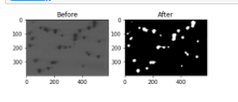
Bandpass Filter
Modified part of example
a1 = cv2.cvtColor(a, cv2.COLOR_BGR2GRAY)
# Thresholding the image to obtain cell pixels.
thresh,b1 = cv2.threshold(a1, 0, 255,
cv2.THRESH_BINARY_INV+cv2.THRESH_OTSU)
# Since Otsu's method has over segmented the image
# erosion operation is performed.
b2 = cv2.erode(b1, None,iterations = 2)
# Distance transform is performed
dist_trans = cv2.distanceTransform(b2, 2, 3)
# Thresholding the distance transform image to obtain
# pixels that are foreground.
thresh, dt = cv2.threshold(dist_trans, 1,
255, cv2.THRESH_BINARY)
# Performing labeling.
labelled, ncc = label(dt)
# Performing watershed.
cv2.watershed(a, labelled)
# Saving the image as watershed_output.png
fig = plt.figure()
ax = fig.add_subplot(1, 2, 1)
imgplot = plt.imshow(a, cmap='gray')
ax.set_title('Before')
ax = fig.add_subplot(1, 2, 2)
imgplot = plt.imshow(b2, cmap='gray')#change b to b2
ax.set_title('After')
plt.show()

Slide 40
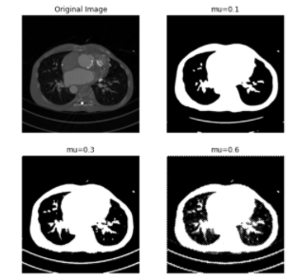
Chan-Vese Segmentation
Modified part of example
cv1 = chan_vese(img, mu=0.1)
cv2 = chan_vese(img, mu=0.3)
cv3 = chan_vese(img, mu=0.6)
fig, axes = plt.subplots(2, 2, figsize=(8, 8))
ax = axes.flatten()
ax[0].imshow(img, cmap="gray")
ax[0].set_axis_off()
ax[0].set_title("Original Image", fontsize=12)
ax[1].imshow(cv1, cmap="gray")
ax[1].set_axis_off()
ax[1].set_title("mu=0.1", fontsize=12)
ax[2].imshow(cv2, cmap="gray")
ax[2].set_axis_off()
ax[2].set_title("mu=0.3", fontsize=12)
ax[3].imshow(cv3, cmap="gray")
ax[3].set_axis_off()
ax[3].set_title("mu=0.6", fontsize=12)
#plt.imshow(img)
plt.show()

Slide 41
CH9

Slide 42
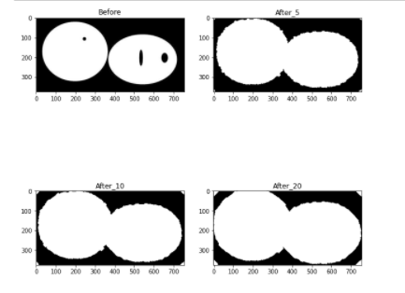
Dilation
Modified part of example
# cv2.waitKey(0)
fig = plt.figure(figsize=(10, 10))
ax = fig.add_subplot(2, 2, 1)
imgplot = plt.imshow(a, cmap='gray',vmin=0,vmax=255)
ax.set_title('Before')
ax = fig.add_subplot(2, 2, 2)
imgplot = plt.imshow(b, cmap='gray')
ax.set_title('After_5')
ax = fig.add_subplot(2, 2, 3)
imgplot = plt.imshow(c, cmap='gray')
ax.set_title('After_10')
ax = fig.add_subplot(2, 2, 4)
imgplot = plt.imshow(d, cmap='gray')
ax.set_title('After_20')
plt.show()

Slide 43
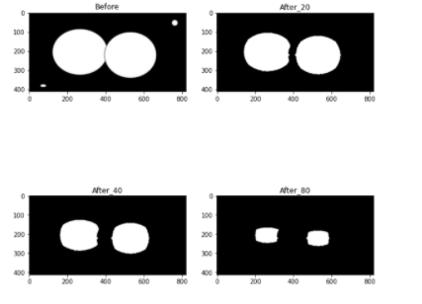
Erosion
Modified part of example
b = snd.morphology.binary_erosion(a,iterations=20)
c = snd.morphology.binary_erosion(a,iterations=40)
d = snd.morphology.binary_erosion(a,iterations=80)
# Saving the image as 8-bit as b is a
# binary image of dtype=bool
fig = plt.figure(figsize=(10, 10))
ax = fig.add_subplot(2, 2, 1)
imgplot = plt.imshow(a, cmap='gray')
ax.set_title('Before')
ax = fig.add_subplot(2, 2, 2)
imgplot = plt.imshow(b, cmap='gray')
ax.set_title('After_20')
ax = fig.add_subplot(2, 2, 3)
imgplot = plt.imshow(c, cmap='gray')
ax.set_title('After_40')
ax = fig.add_subplot(2, 2, 4)
imgplot = plt.imshow(d, cmap='gray')
ax.set_title('After_80')
plt.show()

Slide 44
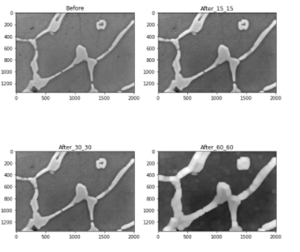
Grayscale Dilation and Erosion
Modified part of example
# Performing grey dilation.
b = scipy.ndimage.morphology.grey_dilation(a, footprint=footprint)
c = scipy.ndimage.morphology.grey_dilation(a, footprint=footprint1)
d = scipy.ndimage.morphology.grey_dilation(a, footprint=footprint2)
# Converting ndarray to image.
c = Image.fromarray(b)
# Saving the image.
fig = plt.figure(figsize=(10, 10))
ax = fig.add_subplot(2, 2, 1)
imgplot = plt.imshow(a, cmap='gray')
ax.set_title('Before')
ax = fig.add_subplot(2, 2, 2)
imgplot = plt.imshow(b, cmap='gray')
ax.set_title('After_15_15')
ax = fig.add_subplot(2, 2, 3)
imgplot = plt.imshow(c, cmap='gray')
ax.set_title('After_30_30')
ax = fig.add_subplot(2, 2, 4)
imgplot = plt.imshow(d, cmap='gray')
ax.set_title('After_60_60')
plt.show()

Slide 45
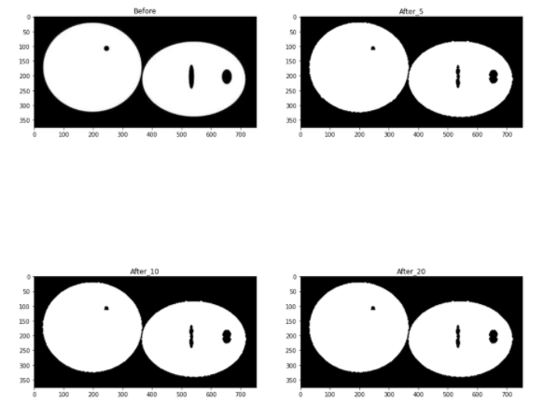
Opening and Closing
Modified part of example
a = np.array(a)
# Defining the structuring element.
s = [[0,1,0],[1,1,1], [0,1,0]]
# Performing the binary opening for 5 iterations.
b = snd.morphology.binary_opening(a, structure=s, iterations=5)
c = snd.morphology.binary_opening(a, structure=s, iterations=10)
d = snd.morphology.binary_opening(a, structure=s, iterations=20)
# Saving the image as 8-bit as b is a
# binary image of dtype=bool
fig = plt.figure(figsize=(15, 15))
ax = fig.add_subplot(2, 2, 1)
imgplot = plt.imshow(a, cmap='gray')
ax.set_title('Before')
ax = fig.add_subplot(2, 2, 2)
imgplot = plt.imshow(b, cmap='gray')
ax.set_title('After_5')
ax = fig.add_subplot(2, 2, 3)
imgplot = plt.imshow(c, cmap='gray')
ax.set_title('After_10')
ax = fig.add_subplot(2, 2, 4)
imgplot = plt.imshow(d, cmap='gray')
ax.set_title('After_20')
plt.show()

Slide 46
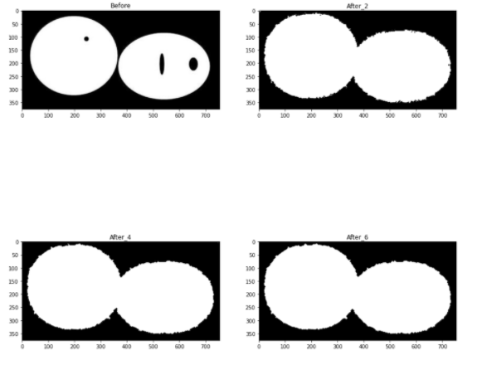
Opening and Closing
Modified part of example
# Defining the structuring element.
s = [[0,1,0],[1,1,1], [0,1,0]]
# Performing the binary closing for 5 iterations.
b = snd.morphology.binary_closing(a,structure=s,iterations=2)
c = snd.morphology.binary_closing(a,structure=s,iterations=4)
d = snd.morphology.binary_closing(a,structure=s,iterations=6)
# Saving the image as 8-bit as b is a
# binary image of dtype=bool
fig = plt.figure(figsize=(15, 15))
ax = fig.add_subplot(2, 2, 1)
imgplot = plt.imshow(a, cmap='gray')
ax.set_title('Before')
ax = fig.add_subplot(2, 2, 2)
imgplot = plt.imshow(b, cmap='gray')
ax.set_title('After_2')
ax = fig.add_subplot(2, 2, 3)
imgplot = plt.imshow(c, cmap='gray')
ax.set_title('After_4')
ax = fig.add_subplot(2, 2, 4)
imgplot = plt.imshow(d, cmap='gray')
ax.set_title('After_6')
plt.show()

Slide 47
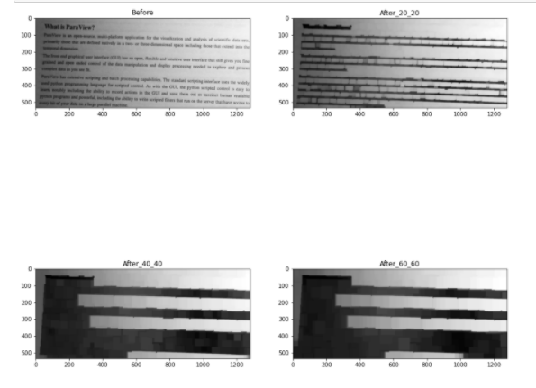
Grayscale Opening and Closing
Modified part of example
# Creating a structuring element.
footprint = np.ones((20,20))
footprint1 = np.ones((40,40))
footprint2 = np.ones((60,60))
# Performing grey opening.
b = scipy.ndimage.morphology.grey_opening(a, footprint=footprint)
c1 = scipy.ndimage.morphology.grey_opening(a, footprint=footprint1)
d = scipy.ndimage.morphology.grey_opening(a, footprint=footprint2)
# Converting ndarray to image.
c = Image.fromarray(b)
# Saving the image.
c.save('/content/drive/MyDrive/DIP colab/OUTPUT/grey_opening_output_40.png')
fig = plt.figure(figsize=(15, 15))
ax = fig.add_subplot(2, 2, 1)
imgplot = plt.imshow(a, cmap='gray')
ax.set_title('Before')
ax = fig.add_subplot(2, 2, 2)
imgplot = plt.imshow(b, cmap='gray')
ax.set_title('After_20_20')
ax = fig.add_subplot(2, 2, 3)
imgplot = plt.imshow(c1, cmap='gray')
ax.set_title('After_40_40')
ax = fig.add_subplot(2, 2, 4)
imgplot = plt.imshow(d, cmap='gray')
ax.set_title('After_60_60')
plt.show()

Slide 48

grayscale closing
Modified part of example
bg = scipy.ndimage.morphology.grey_closing(a, footprint=fp)
# bg represents the background.
# We will subtract bg from a to remove the background in a.
bg_free = (a.astype(np.float64) - bg.astype(np.float64))
# We rescale bg_free to 0 to 255.
denom = (bg_free.max()-bg_free.min())
bg_free_norm = (bg_free - bg_free.min())*255/denom
# Converting bg_free_norm to uint8.
bg_free_norm = bg_free_norm.astype(np.uint8)
# Converting bg_free_norm and bg to images.
bg_free_norm = Image.fromarray(bg_free_norm)
bg = Image.fromarray(bg)
# Saving the background image.
bg.save('/content/drive/MyDrive/DIP colab/OUTPUT/grey_closing_out_40.png')
# Saving the bg_free_norm image.
bg_free_norm.save('/content/drive/MyDrive/DIP colab/OUTPUT/closing_bgfree.png')
fig = plt.figure()
ax = fig.add_subplot(1, 2, 1)
imgplot = plt.imshow(a, cmap='gray')
ax.set_title('Before')
ax = fig.add_subplot(1, 2, 2)
imgplot = plt.imshow(b, cmap='gray')
ax.set_title('After')
plt.show()

Slide 49
CH10

Slide 50
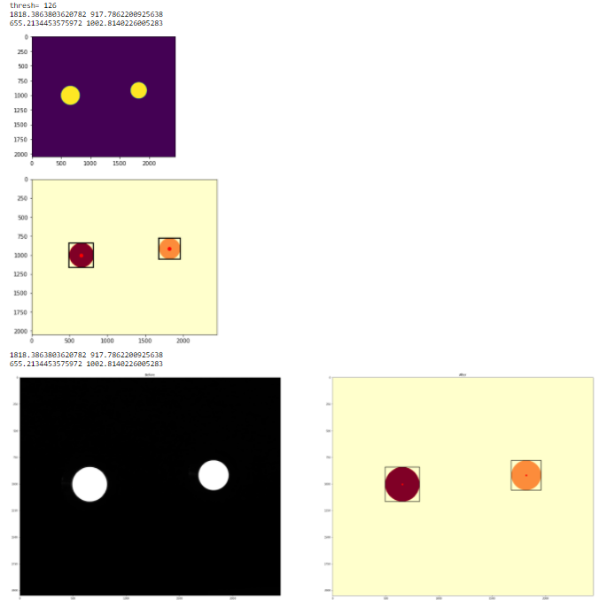
Labeling
Modified part of example
# Saving the figure
plt.savefig('/content/drive/MyDrive/DIP colab/OUTPUT/RCIMD_SC_TEST1_output1.jpg')
plt.show()
c1 = label(b)
# c is saved as label_output.png
# On the labelled image c, regionprops is performed
d1 = regionprops(c1)
fig = plt.figure(figsize=(40, 40))
ax = fig.add_subplot(1, 2, 1)
imgplot = plt.imshow(a, cmap='gray')
ax.set_title('Before')
ax = fig.add_subplot(1, 2, 2)
imgplot = plt.imshow(c1, cmap='YlOrRd')
ax.set_title('After')
for i in d1:
# Printing the x and y values of the
# centroid where centroid[1] is the x value
# and centroid[0] is the y value.
print(i.centroid[1], i.centroid[0])
# Plot a red circle at the centroid, ro stands
# for red.
plt.plot(i.centroid[1],i.centroid[0],'ro')
# In the bounding box, (lr,lc) are the
# co-ordinates of the lower left corner and
# (ur,uc) are the co-ordinates
# of the top right corner.
lr, lc, ur, uc = i.bbox
# The width and the height of the bounding box
# is computed.
rec_width = uc - lc
rec_height = ur - lr
# Rectangular boxes with
# origin at (lr,lc) are drawn.
rect = mpatches.Rectangle((lc, lr),rec_width,
rec_height,fill=False,edgecolor='black',
linewidth=2)
# This adds the rectangular boxes to the plot.
ax.add_patch(rect)
plt.savefig('/content/drive/MyDrive/DIP colab/OUTPUT/RCIMD_SC_TEST1_c1.png')
plt.show()

Slide 51
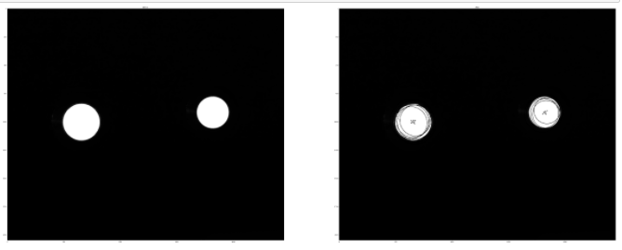
Hough Circle
Modified part of example
# opening the image and converting it to grayscale
a = Image.open('/content/drive/MyDrive/DIP colab/RCIMD_SC_TEST1.jpg')
a = a.convert('L')
# Median filter is performed on the
# image to remove noise.
img = scipy.ndimage.filters.median_filter(a,size=10)
# Circles are determined using
# Hough circles transform.
circles = cv2.HoughCircles(img,
cv2.HOUGH_GRADIENT,1,10,param1=100,
param2=30,minRadius=100,maxRadius=300)
# circles image is rounded to unsigned integer 16.
circles = np.uint16(np.around(circles))
# For each detected circle.
for i in circles[0,:]:
# An outer circle is drawn for visualization.
cv2.circle(img,(i[0],i[1]),i[2],(0,255,0),2)
# its center is marked
cv2.circle(img,(i[0],i[1]),2,(0,0,255),3)
# Saving the image as houghcircles_output.png
fig = plt.figure(figsize=(80, 80))
ax = fig.add_subplot(1, 2, 1)
imgplot = plt.imshow(a, cmap='gray')
ax.set_title('Before')
ax = fig.add_subplot(1, 2, 2)
imgplot = plt.imshow(img, cmap='gray')
ax.set_title('After')
plt.savefig('/content/drive/MyDrive/DIP colab/OUTPUT/RCIMD_SC_TEST1_1_Hough Circle.png')
plt.show()

Slide 52
CH11

Slide 53

Neural Network Example Code
Modified part of example
# Size of image is 28x28x1 channel.
input_shape = (28, 28, 1)
batch_size = 64
# number of possible outcomes [0-9]
nclasses = 10
epochs = 3
# Fetch the train and test data.
(x_train, y_train), (x_test, y_test) = mnist.load_data()
# Normalize the image so that all pixel values
# are between -0.5 and +0.5.
x_train = (x_train / 255) - 0.5
x_test = (x_test / 255) - 0.5
# Reshape the train and test images to size 28x28x1.
x_train = x_train.reshape((x_train.shape[0], *input_shape))
x_test = x_test.reshape((x_test.shape[0], *input_shape))
# Define the CNN model with 2 convolution layer and
# 2 max pooling layer followed by a neural network
# with 1 hidden layer of size 128 nodes.
model = Sequential()
model.add(Conv2D(32, kernel_size=(3, 3),
activation='relu',
input_shape=input_shape))
model.add(MaxPooling2D(pool_size=(2, 2)))
model.add(Conv2D(64, (3, 3), activation='relu'))
model.add(MaxPooling2D(pool_size=(2, 2)))
model.add(Flatten())
model.add(Dense(128, activation='relu'))
model.add(Dense(nclasses, activation='softmax'))
# Compile the model using Adam optimizer and use
# the cross entropy loss.
model.compile(optimizer='adam',
loss='categorical_crossentropy',
metrics=['accuracy'])
# Train the model.
model.fit(x_train, to_categorical(y_train), epochs=epochs,
batch_size=batch_size)
# Evaluate the model.
score = model.evaluate(x_test, to_categorical(y_test), verbose=0)
print('Test loss:', score[0])
print('Test accuracy:', score[1])
#plt.imshow(model)
plt.show()

